Slide 1

MALLA REDDY COLLEGE OF ENGINEERING FOR WOMEN An UGC Autonomous Institution Approved by AICTE New Delhi and Affiliated to JNTU An ISO 9001: 2015 Certified Institution Accredited by NBA and IIC 4-star Rating India Rankings 2023-NIRF Innovation Band 151-300 Maisammaguda, Medchal (Dist), Hyderabad -500100, Telangana. Tel: 9346118802 Email : rg.mrcew@gmail.com, www.mrcew.ac.in
EAMCET Code: MREW
JNTUH Code: RG
DEPARTMENT OF COMPUTER SCIENCE AND ENGINEERING
SECURE SENSE AI: PRIVACY PRESERVING MACHINE LEARNING FOR SMART INDUSTRY
PRESENTED BY: UNDER GUIDANCE OF:
H.ESHWARI 22RG1A0588
M.SRAVANI 22RG1A05A4 Mrs.SUNEETA
P.ALEKHYA 22RG1A05B0
S.CHANDRAKALA 22RG5A05C0

Slide 2
CONTENT
Abstract
Introduction
Existing System
Proposed Method
Hardware & Software Requirements
Advantages
Applications
Result Analysis
Future Scope
Conclusion
References

Slide 3
ABSTRACT
The IIoT systems use sensors, communication, and machine learning to improve automation, productivity, and decision-making in industries, but they face major privacy and security challenges with sensitive data.
PriModChain is a framework designed to provide privacy-preserving and trustworthy ML model training and sharing in distributed IIoT environments.
It combines Federated Learning, Differential Privacy, Ethereum Blockchain, Smart Contracts, and IPFS to secure data, protect privacy, and enable decentralized model sharing.
The framework improves security, transparency, reliability, and resilience, making it a practical solution for safe ML deployment in IIoT systems.

Slide 4
INTRODUCTION
The Industrial Internet of Things (IIoT) transforms industries by using smart sensors and machine learning to collect and analyze data . It enables Industry 4.0 applications like predictive maintenance and quality control in sectors such as healthcare, energy, and transportation.
However, IIoT systems handle large amounts of sensitive and distributed data, which raises serious concerns about privacy, security, and trust. Machine learning models trained on such data are vulnerable to attacks like data leakage and tampering.
To address this challenge, Our project introduces PriModChain, a privacy-preserving ML framework for IIoT that uses Federated Learning, Differential Privacy, Blockchain, Smart Contracts, and IPFS for secure and reliable model training and sharing.
This approach ensures secure data handling, transparency, and resilience, making it a strong solution for safe and trustworthy ML deployment in IIoT environments.
.

Slide 5
EXISTING SYSTEM
In the domain of IIoT-based industrial systems, various existing methods are used to improve automation and decision-making. Existing systems typically involve:
Centralized ML Training:Data from multiple devices is collected in a central server for model training, which increases privacy and security risks.
Basic Security Techniques:Traditional encryption and access control are used, but they may not fully prevent data leakage or insider attacks.
Conventional Data Sharing:Organizations share data or models directly, which can expose sensitive information.
Limited Privacy Protection: Most systems do not use advanced privacy techniques, making them vulnerable to inference and tampering attacks.

Slide 6
PROPOSED METHOD
The proposed system introduces a trustworthy and privacy-preserving framework for Industrial IoT (IIoT) environments to enable secure machine learning (ML) model and sharing without exposing sensitive industrial data. The framework integrates Federated Learning (FL), Differential Privacy (DP), Blockchain, Smart Contracts, and IPFS to ensure data confidentiality, integrity, and trust.
System Architecture Design
IIoT Devices/Sensors – Collect industrial data from machines and processes
Local Edge Nodes – Perform local ML training
Blockchain Network (Ethereum) – Ensures trust and transparency
By eliminating centralized control and integrating advanced privacy and security mechanisms, the proposed system offers higher trust, better data protection, and greater resilience while supporting Industry 4.0 applications such as predictive maintenance, smart manufacturing, and quality monitoring.

Slide 7
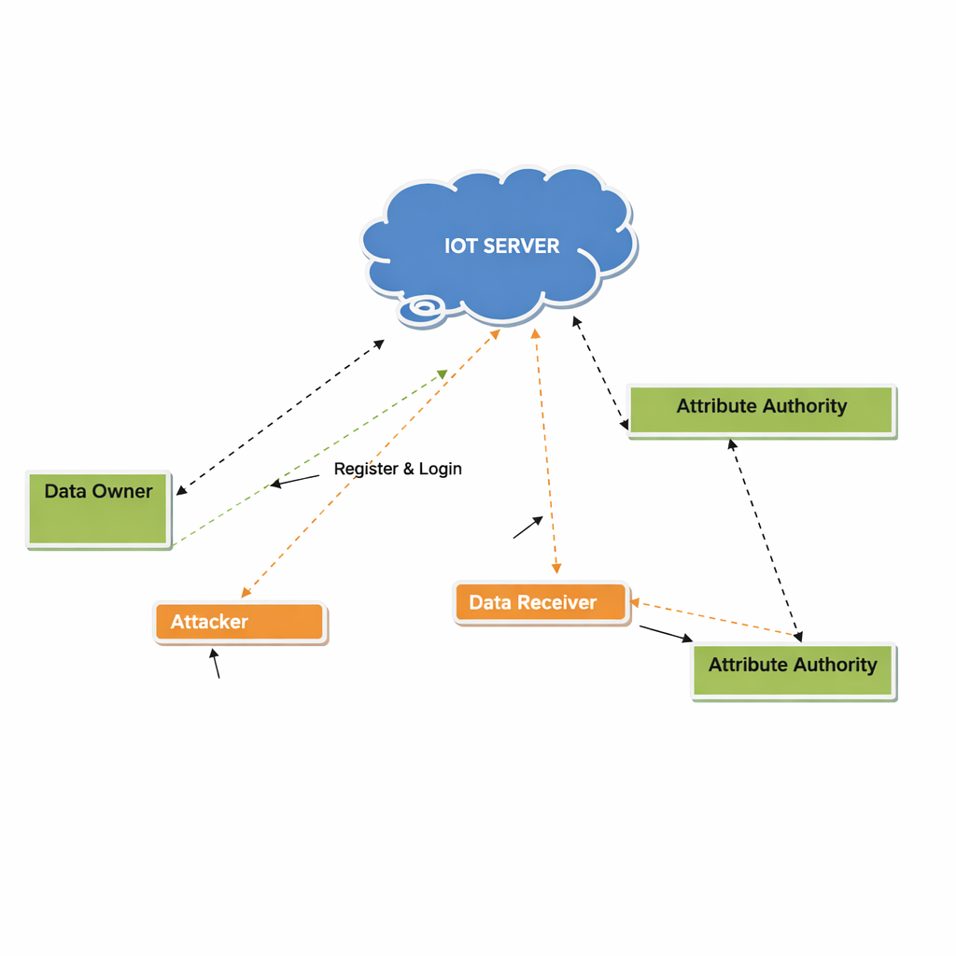
ARCHITECTURE DIAGRAM

Slide 8
REQUIREMENTS:
Hardware Requirements
System : Intell I-3, 5, 7 Processor.
Hard Disk : 500 GB.
Floppy Drive : 1.44 Mb.
Monitor : 14’ Colour Monitor.
Mouse : Optical Mouse.
Ram : 8 GB or above

Slide 9
Software Requirements
Operating system:Windows7,8,10 Ultimate,Linux,Mac.
Front-End : Java
Coding Language: Java
Software Environment: PriModChain (IIoT + ML + Blockchain)

Slide 10

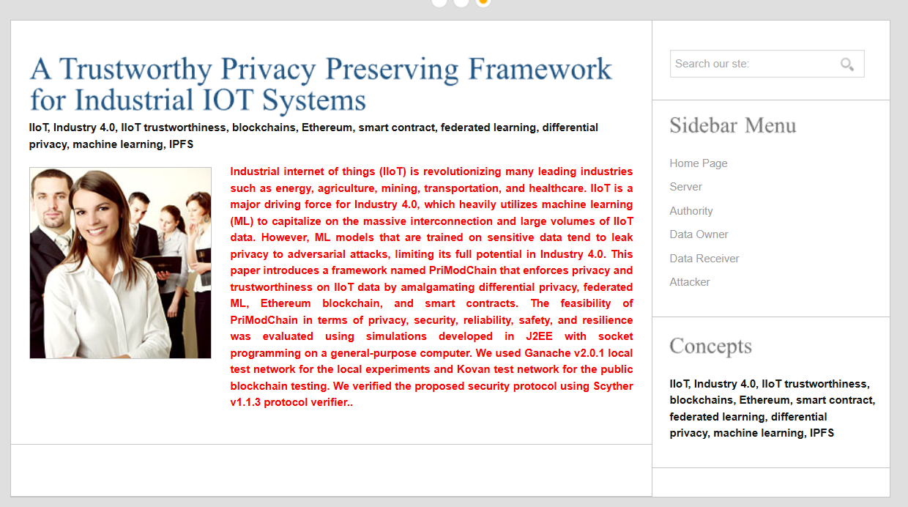
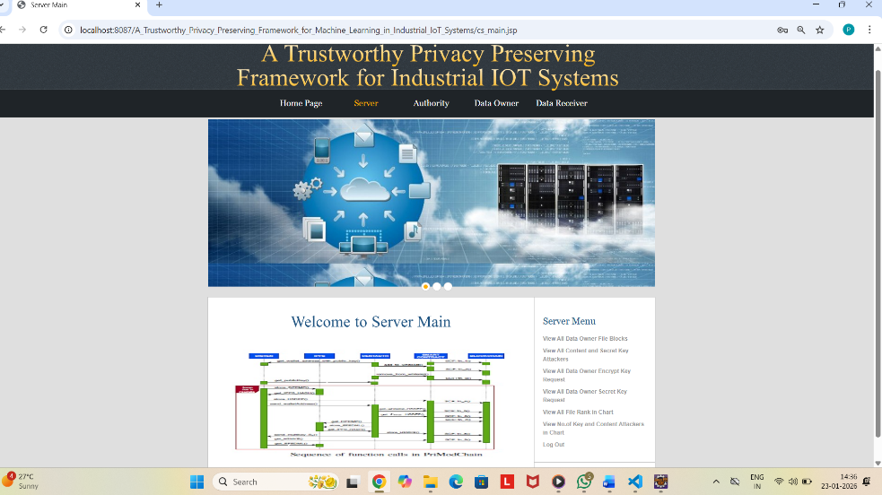

OUTPUT RESULTS

Slide 11

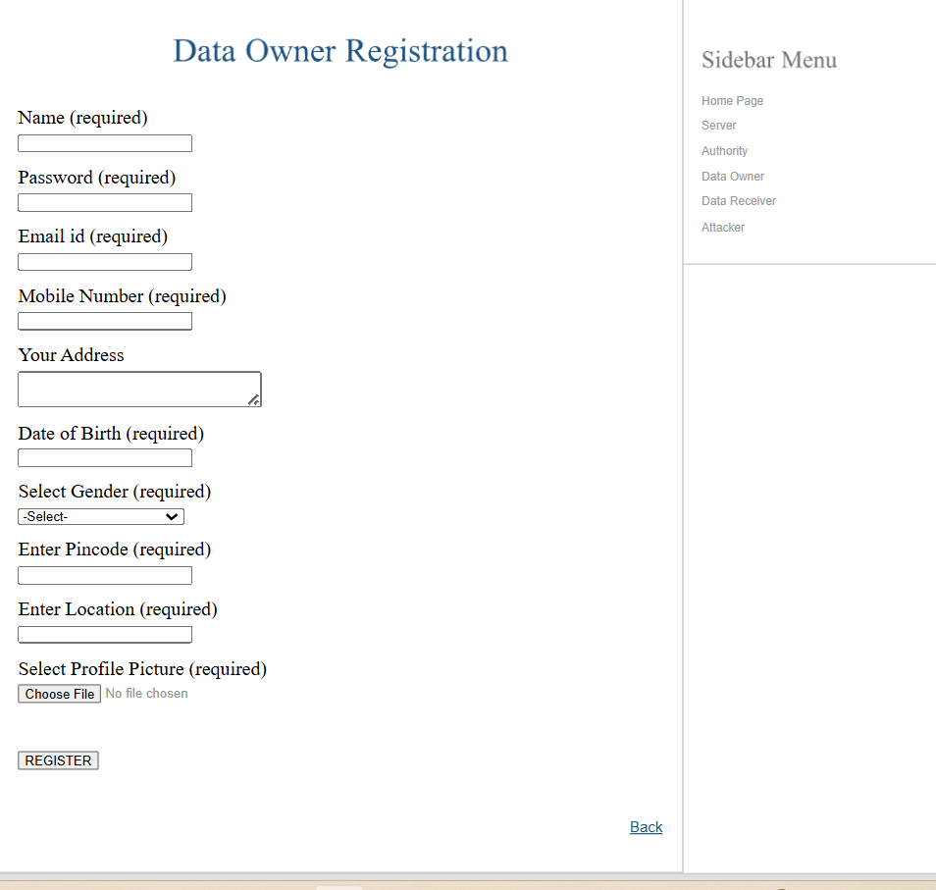
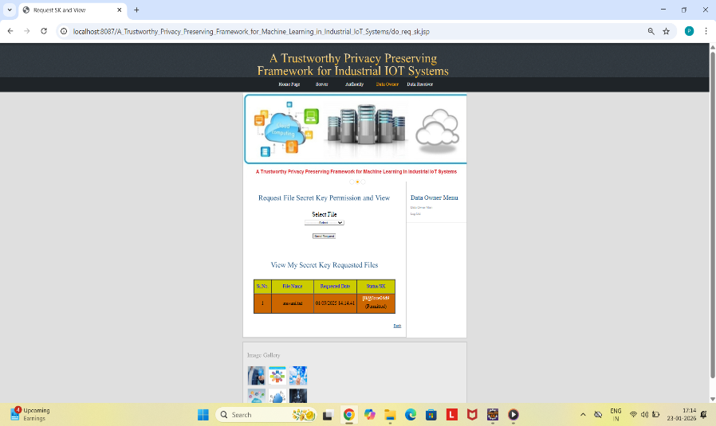
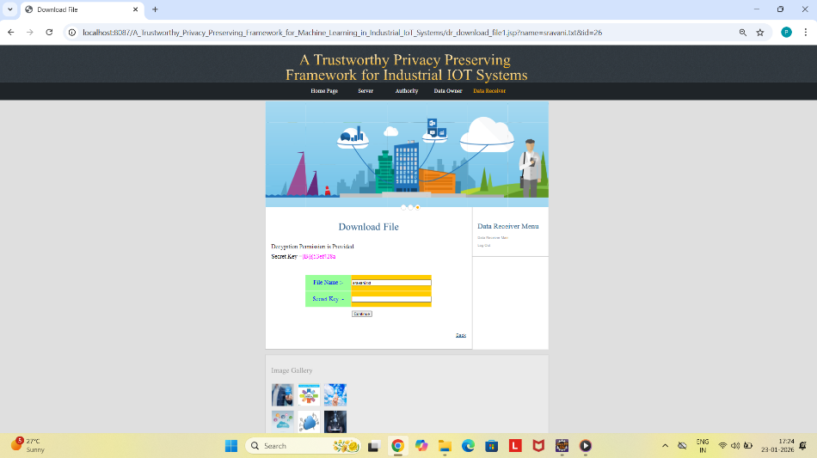

Slide 12
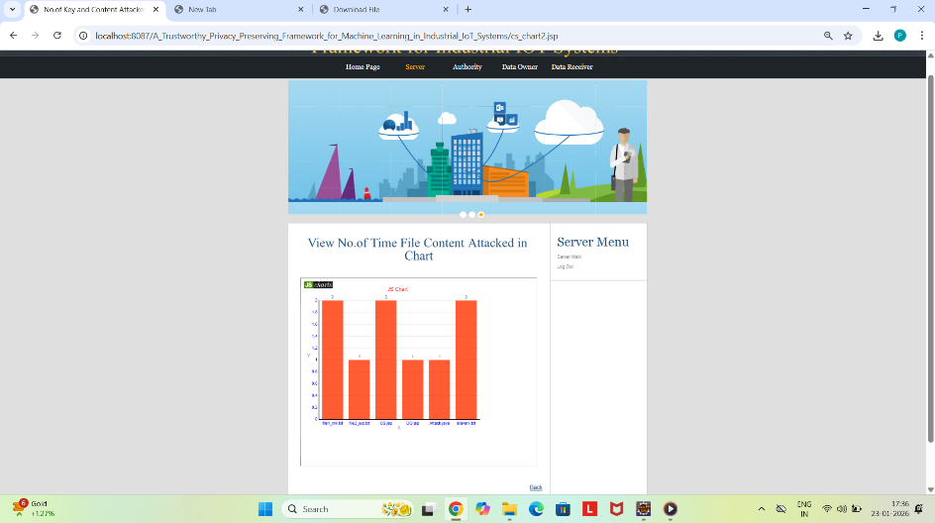
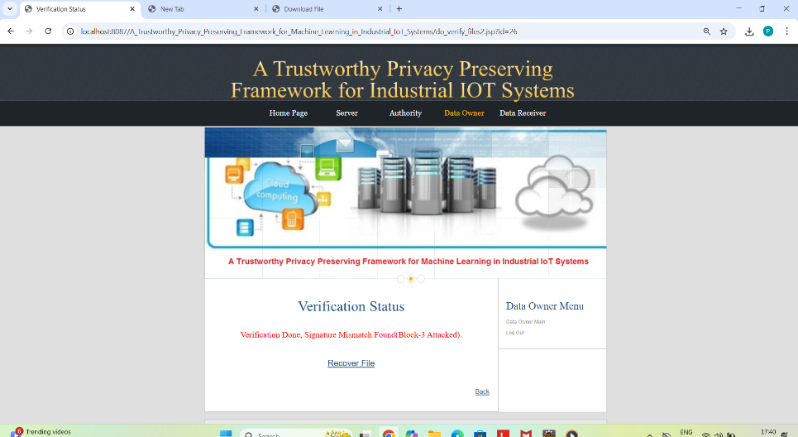
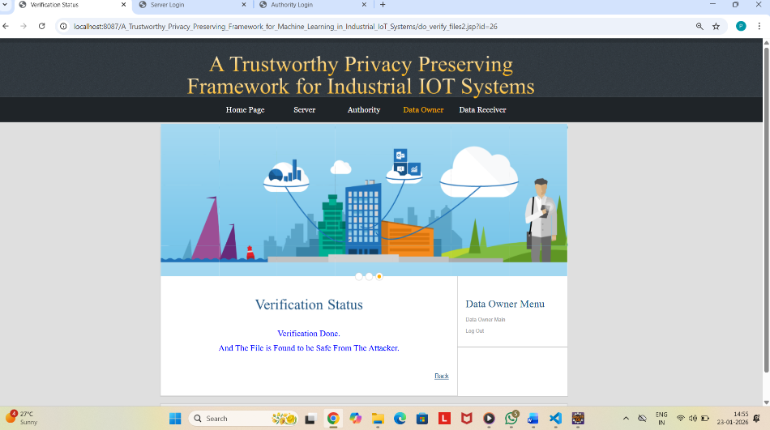

Slide 13
ADVANTAGES:
Privacy Protection: PriModChain uses Federated Learning and Differential Privacy to ensure that raw data remains with the data owners, reducing the risk of data leakage and protecting sensitive information.
High Security:The use of Blockchain and Smart Contracts provides strong security by preventing unauthorized changes and ensuring tamper-proof operations.
Transparency & Traceability:Blockchain records all transactions permanently, allowing easy tracking and verification of model updates and data exchanges.
Decentralized Storage: IPFS enables secure and low-latency decentralized storage, ensuring fast access and safe sharing of ML models.

Slide 14
APPLICATIONS:
Monitoring and optimizing energy production and consumption in smart grids and energy systems.
Secure sharing of medical data and machine learning models in healthcare while protecting patient privacy.
Improving traffic management, vehicle monitoring, and supply chain operations in transportation and logistics.
Collecting and analyzing agricultural data for crop monitoring and precision farming.
Supporting predictive maintenance and quality control in industrial automation and manufacturing.
Enabling secure and intelligent services in smart cities such as surveillance and infrastructure management.

Slide 15
CONCLUSION:
The PriModChain is a novel framework developed for trustworthy and privacy-preserving machine learning and model sharing in IIoT environments, addressing key issues of data privacy and trust.
Overall, this project highlights that PriModChain provides a secure, privacy-preserving, and trustworthy machine learning framework for IIoT by combining Federated Learning, Differential Privacy, Blockchain, Smart Contracts, and IPFS to enable safe and decentralized model training and sharing.
Future enhancements may include reducing latency and optimizing efficiency to further improve system performance in real-world IIoT deployments.

Slide 16
FUTURE SCOPE:
The system can be expanded to support large-scale IIoT networks and real-time data processing for better scalability.
Advanced AI and deep learning models can be integrated to improve accuracy and automation.
Stronger security methods can be added to protect against cyber threats and data breaches.
The framework can be applied to smart cities, healthcare, transportation, and energy sectors.
Edge and cloud computing integration can reduce delay and improve processing efficiency.
Blockchain and storage optimization can reduce cost and energy consumption.

Slide 17
REFERENCES:
R. Iqbal, T. Maniak, F. Doctor, and C. Karyotis, “Fault detection and
isolation in industrial processes using deep learning approaches,”
,” IEEE Transactions on Industrial Informatics, vol. 15, no. 5, pp. 3077–3084,
2019.
S. A. Shevchik, G. G. Masinelli, C. Kenel, C. Leinenbach, and K. Wasmer, “Deep learning for in situ and real-time quality monitoring in additive manufacturing using acoustic emission,” IEEE Transactions on Industrial Informatics, 2019.
M. S. Hossain, M. Al-Hammadi, and G. Muhammad, “Automatic fruit
classification using deep learning for industrial applications,” IEEE
Transactions on Industrial Informatics, vol. 15, no. 2, pp. 1027–1034,
2018.
R. S. Peres, A. D. Rocha, P. Leitao, and J. Barata, “Idarts–towards
intelligent data analysis and real-time supervision for industry 4.0,”
Computers in Industry, vol. 101, pp. 138–146, 2018.

Slide 18
THANK YOU

